Slide 1

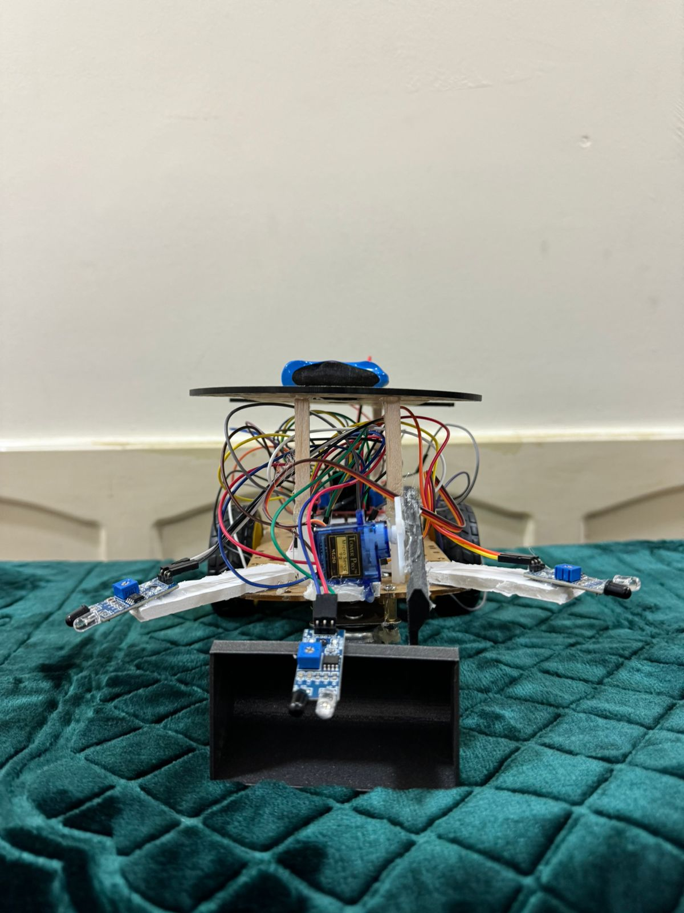
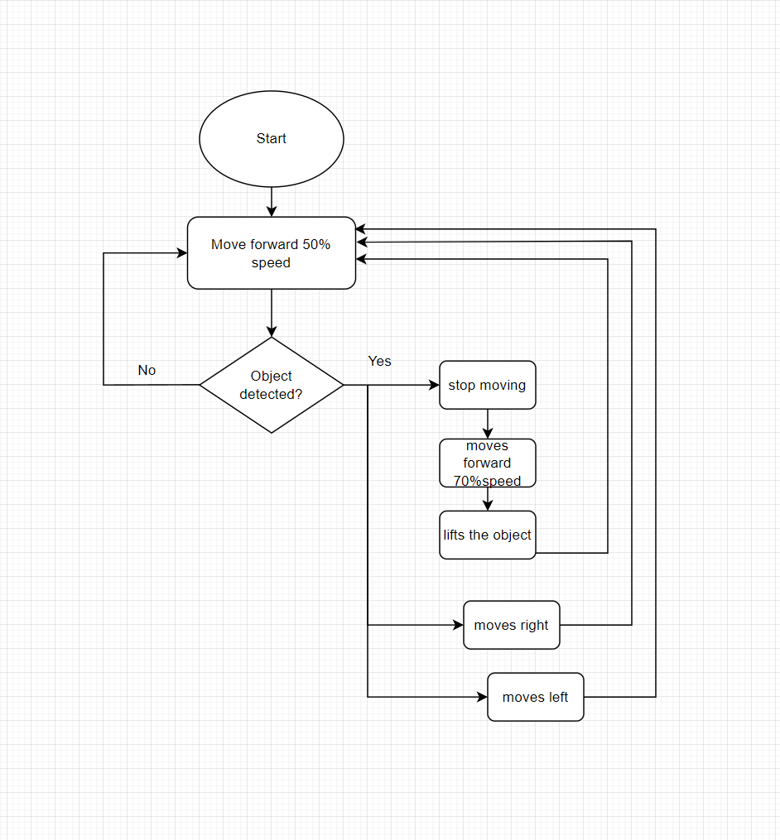
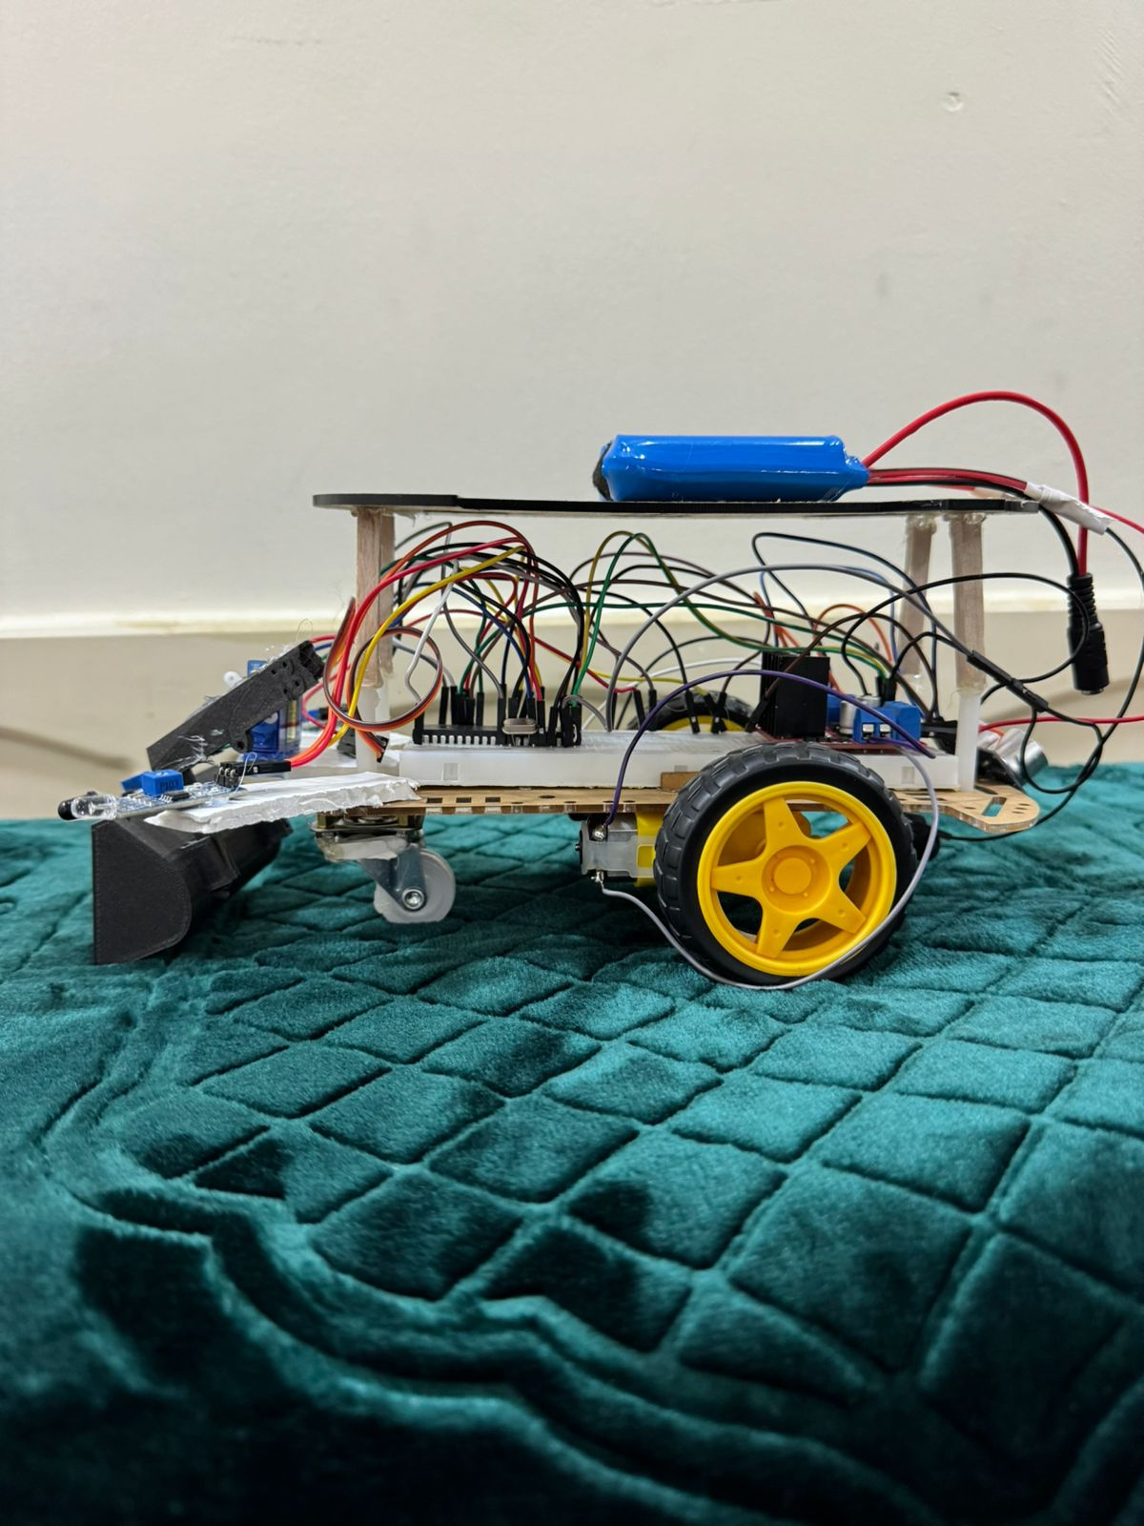
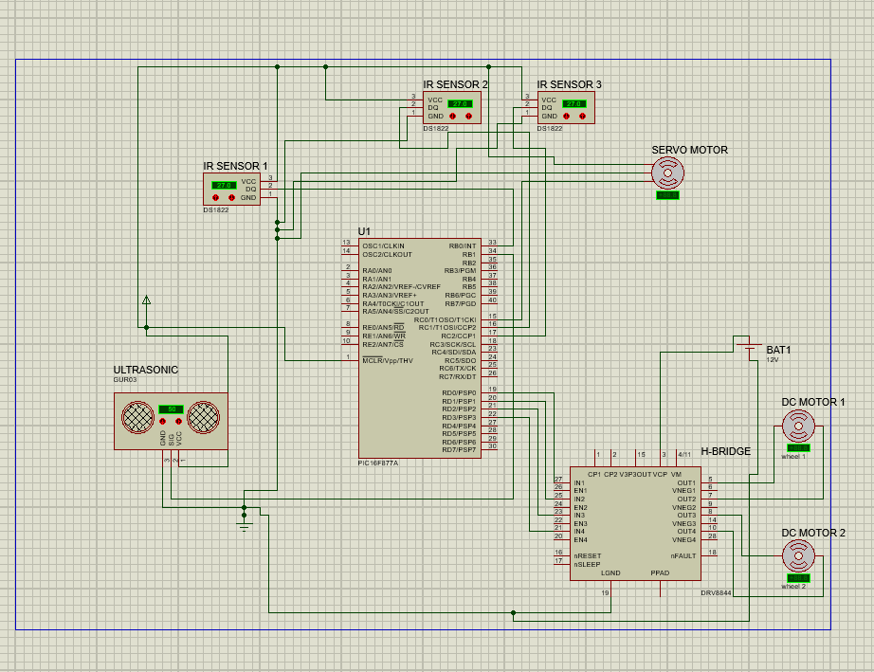
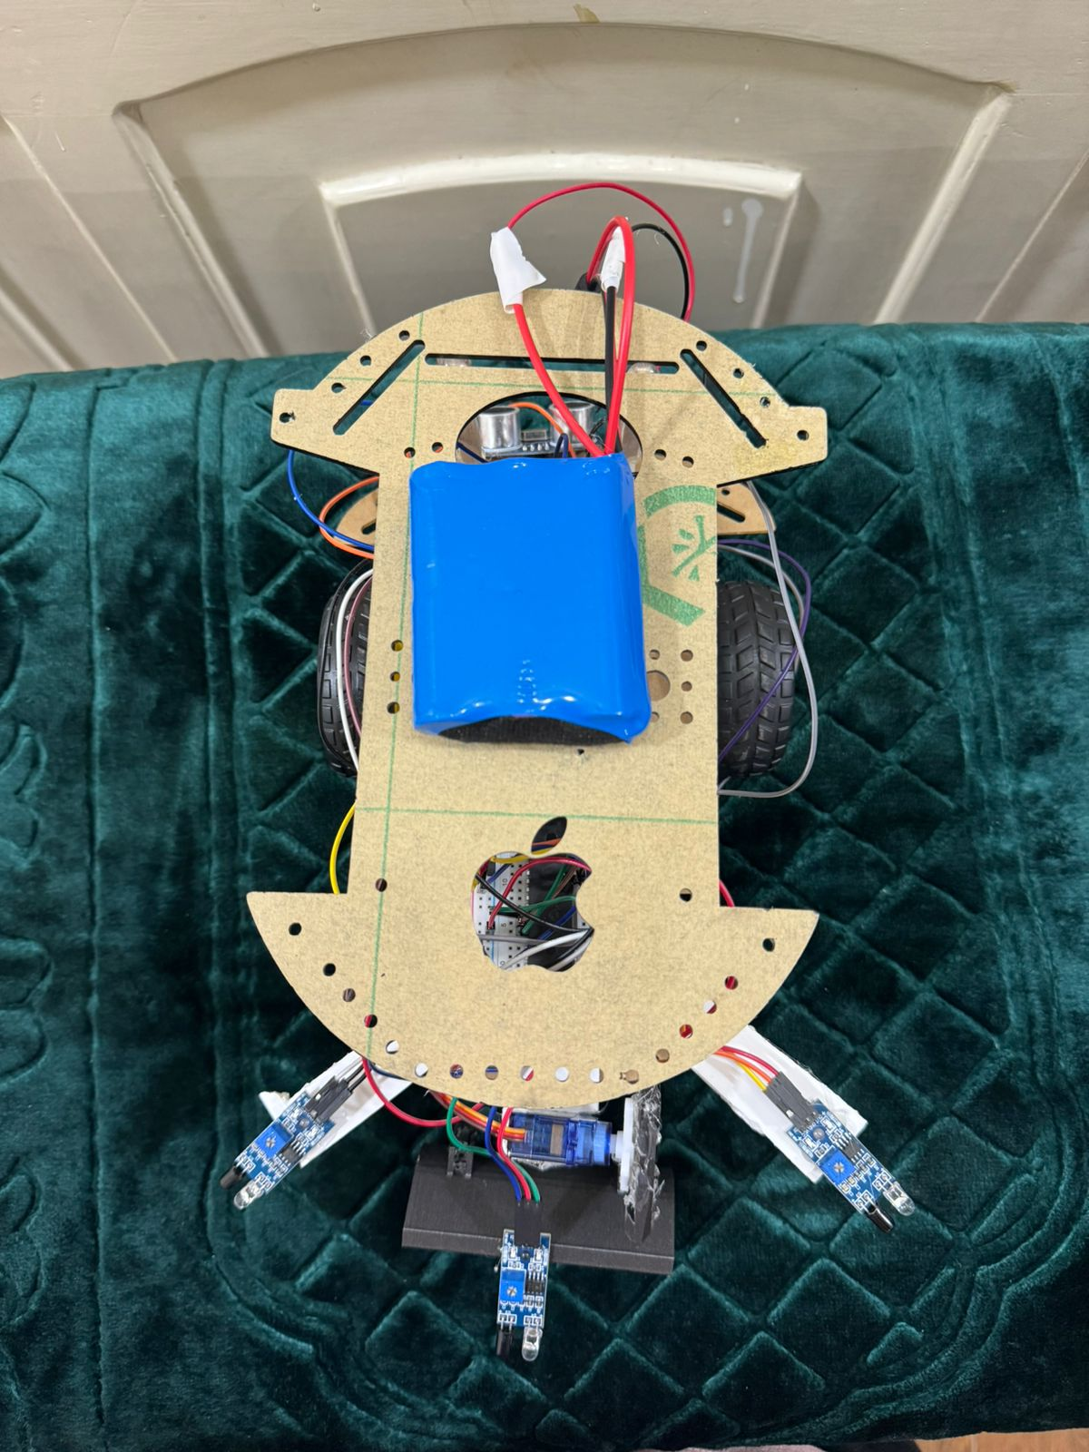
Sensored Bulldozer
E.Alalawneh , M.Saidi
Supervisor: Prof.Belal Sababha
Dr.Anastassia Gharib
Embedded Systems Final Design Project, Spring 2024
King Abdullah II School of Engineering
Princess Sumaya University for Technology
Introduction
The purpose of this project is to build and create a little bulldozer that moves in response to a sensor that is linked to it—in this example, an IR- sensor—using the PIC16F877A microcontroller and an easy-to-read C-code program. The sensor's job is to measure a certain distance and provide a signal to the microcontroller, which interprets the data, moves the bulldozer blade, and instructs the wheels to stop. In terms of the project's mechanical aspects, the bulldozer will be moved up by a servo motor that is attached to its blade and has two wheels with a basic DC motor on each wheel that are both connected to a quadruple half-H bridge.
Results
The bulldozer blade was 3D printed and physically connected to the servo motor. The IR sensor is slightly angled downward to detect small objects on the ground.
Figure 3: Front View.
Figure 4: Side View.
Figure 5: Top View.
Design
Figure 1: Software design.
The IR sensors sends a signal which raises the external interrupt causing the wheels to stop, and afterwards moving the wheels faster using PWM to make lifting the object easier. Since it is an interrupt there is no delay.
Figure 2: Hardware Schematic.
Conclusion
After testing the bulldozer, it performs what is required of it automatically, the wheels move at 50% of its speed at the start by software PWM, and as soon as the IR sensor detects an object, the bulldozer moves 20% faster to make the object enter the blade before lifting occurs. The only human interaction required is lowering the servo motor to collect the object, The use of interrupts instead of regular if-statements when detecting an object removes any sort of delay by the program counter and makes the process faster and more effective.
In terms of the mechanical aspect, two wheels (in addition to the built-in support wheel) were enough to keep the bulldozer balanced and moving in a straight path, as opposed to four wheels which would have added unnecessary cost.

